Slide 1

HR Employees Attrition
IBM

Slide 2
Content:
Overview
Attrition
Dataset
Business objective
Data preparation
Data exploratory
Attrition analysis
Outliers
Recommendations

Slide 3
Overview
This dataset is from IBM HR Analytics Employee Attrition & Performance. It has 35 features describing each employee’s background and characteristics; and labeled with whether they are still in the company or whether they have gone to work somewhere else.

Slide 4
Attrition
Employee attrition refers to the deliberate downsizing of a company's workforce. Downsizing happens when employees resign or retire.
There are a number of reasons why employee attrition takes place.
Examples:
-Unsatisfactory pay and/or benefits
-Poor workplace conditions
-Poor work-life balance
-Relocation

Slide 5
Dataset
Demographic Factors:
Age, Education, Gender, Marital Status…
Work-related Factors:
Business Travel, Department, Monthly Income…

Slide 6
Business Objective
Exploratory data analysis to understand how these factors relate to employee attrition, in order to prevent valuable employees from leaving.

Slide 7
Data Preparation
Remove unnecessary columns:
Employee Count, Over 18, Standard Hours.
Change the wrong data type.
Divide tables & create a “Star Schema”.

Slide 8
Exploratory Data
Founded that :
Employees are: 1470
Attrition employees are : 273
Attrition Rate is : 16%

Slide 9
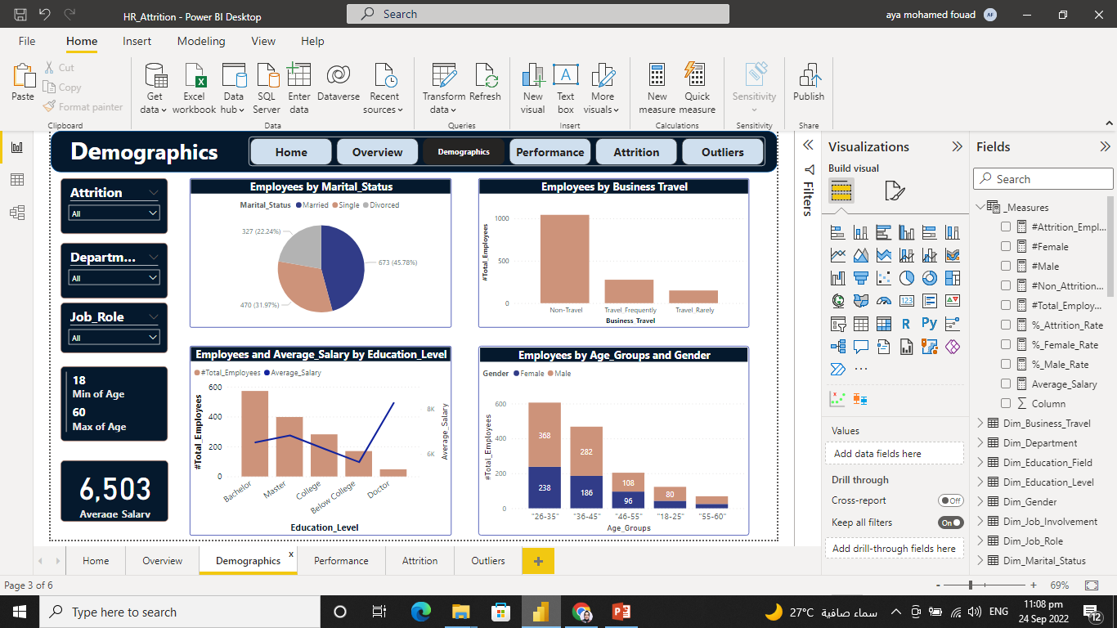
Exploratory Data…
conclusion :
Most employees are married

Slide 10
Exploratory Data…
conclusion :
Most employees are Non-travel.

Slide 11
Exploratory Data…
conclusion :
The employee who has a doctor’s degree has the largest salary.

Slide 12

Exploratory Data…
conclusion :
The most popular employee age group is between 26:35.

Slide 13
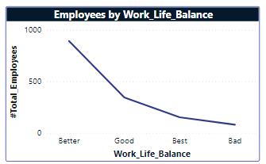
Exploratory Data…
conclusion :
Most Employees have Better work-life balance.

Slide 14

Attrition Analysis

Slide 15
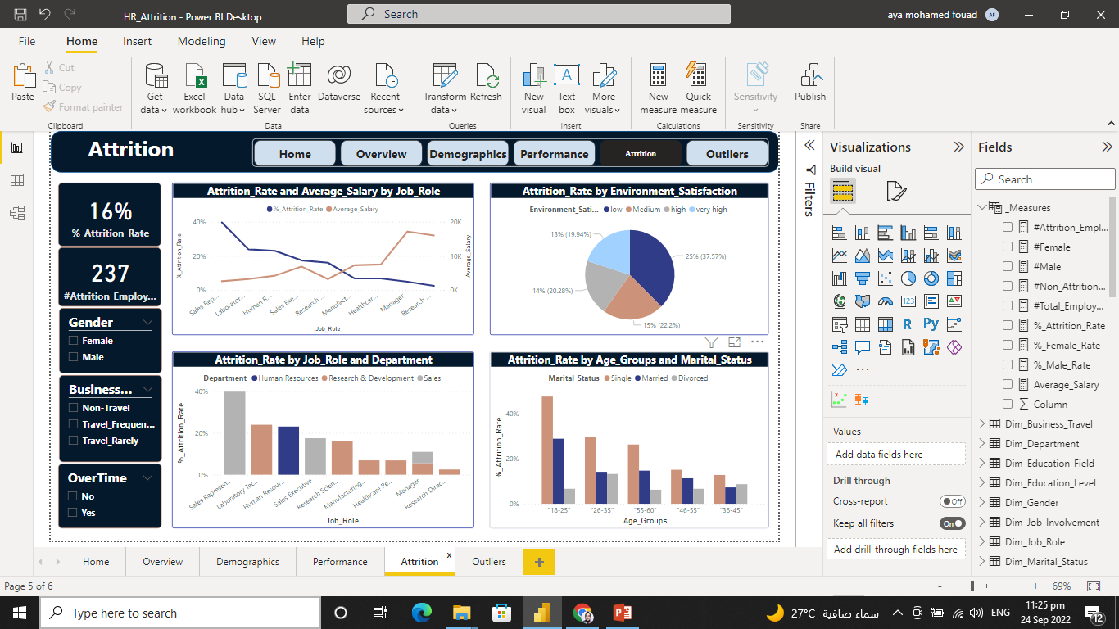
Attrition Analysis…
conclusion :
Employees who have a high salary, have the smallest attrition rate.

Slide 16
Attrition Analysis…
conclusion :
Employees who are in the Sales department, especially in the Sales representative role.

Slide 17
Attrition Analysis…
conclusion :
Employees who have low environmental satisfaction, have the biggest attrition rate.

Slide 18
Attrition Analysis…
conclusion :
Employees who are at 18:25 group age and their marital status are single, have the most attrition rate.

Slide 19
Outliers
An outlier is an observation that lies an abnormal distance from other values.
There are no outliers in:
-Monthly income
-percent salary hike.

Slide 20
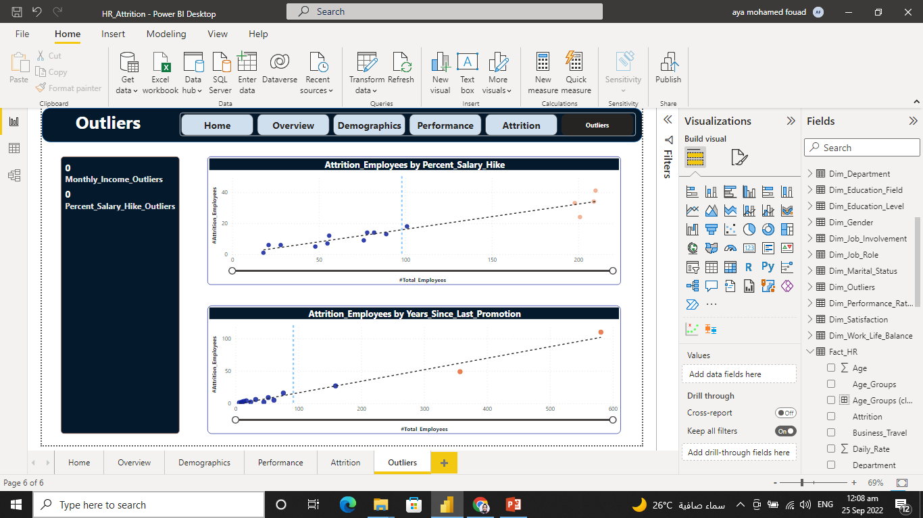
Outliers…
But there are outliers when we group attrition with another factor.
For example:
- percent salary hike.
- years science last promotion.

Slide 21

Recommendations

Slide 22
Recommendations…
To have a low attrition rate, it is important for a company to:
Fairly pay employees in different job roles, in proportion to the average payment in the job market.
consider deeper into the sales department, especially the Sales representative role to understand the reasons for attrition and solve these reasons. For example: increase the payment, and sure that that working overtime is being paid.

Slide 23
Recommendations…
consider the employees' environmental satisfaction, by discussing the reasons for this low satisfaction with them and solve these reasons. Frequent communication and one-on-ones are strongly recommended.
care about juniors in the team, especially those who are single by increasing the learning curve, activities, and awards.

Slide 24
Thanks
Hopefully, to decrease employee attrition in the future with those recommendations.

